Slide 1
To Know from Kellas (2010)
Tie b/w intergen. narrat’s & future Relat. Schemas
Be able to provide examples of each subtype w/i the 4 main Memorable Message supratypes:
Value Self (4 subtypes: independ&time, self-esteem&don’tsettle, progressive sex/rel views, more than 1)
Charac’s of good rel. (5 subs: good qual’s, behav expect, emot/intim expect, homogamy, extend family)
Warnings (3 subs: general, pers regret, judg/expect females)
Sanctity of love (2 subs: virgin&morals, the “one”)
3 main implications drawn from results Discussed

Slide 2
Memorable Messages
Notes:
Basics of Koerner & Fitzpatrick’s (2002) General Theory of Family Comm

Slide 3
Schemas
Like “ ” that affect how we:
Feel
Behave
Communicate
Frame everything
Interact
Ex. Gender schema
Ex. Relational schema

Slide 4
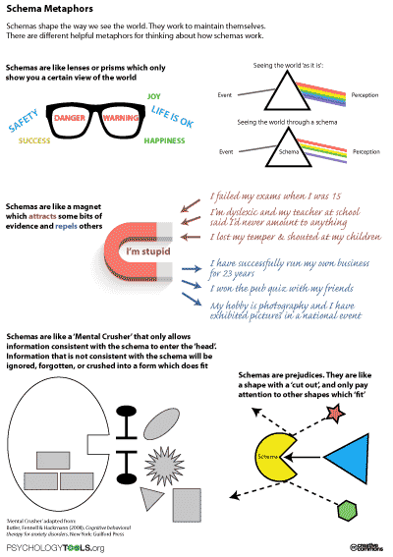

Slide 5
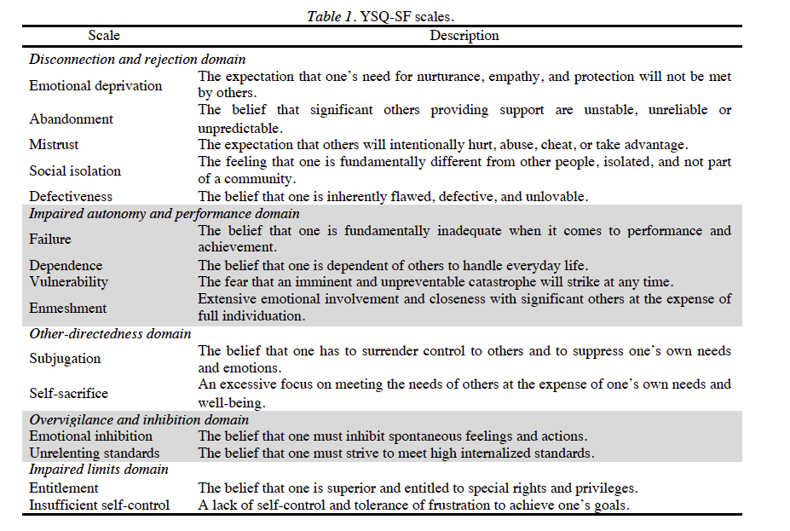

Slide 6
Young’s (2003) Maladaptive Schemas for individuals
Impaired
Entitlement/Grandiosity
Insufficient Self-control &/or Self-discipline
Subjugation
Self-sacrifice
Approval-seeking/Recognition-seeking
Negativity/Pessimism
Emotional Inhibition
Unrelenting Standards/Hypercriticalness
Punitiveness
Abandonment/Instability
Mistrust/Abuse
Emotional Deprivation
Defectiveness/Shame
Social Isolation/Alienation
&/or Performance
Dependence/Incompetence
Vulnerability to Harm or Illness
Enmeshment/Undvlp’d self
Failure

Slide 7
Schemas result in “MODES”
every human experiences some times!
Cluster of schemas & coping styles
Activated by
Life situat’s person finds disturbing/offensive or arouse bad memories
In psych healthy ppl, schema modes →
mild, flexible mind states easily pacified by rest of personality
In “disordered” ppl, schema modes →
more severe, rigid mind states seem “split off” from reg. personality

Slide 8
Mode Types
Child modes
Dysfunctional coping modes
Dysfunctional parent modes
Healthy adult mode

Slide 9
Child Modes
Vulnerable child –
Angry child –
Impulsive/Undisciplined child –
Happy child –

Slide 10
Dysfunctional Coping Modes
Compliant Surrender –
Detached Protector –
Overcompensator –

Slide 11
Dysfunctional Parent Modes
Punitive Parent –
Demanding Parent -

Slide 12
Healthy Adult Mode

Slide 13
… … … lead to Scripts
Remember, from Systems Theory??

Slide 14
One version of ingrained, codified scripts… RITUALS
Can occur:
Daily/Weekly
Yearly (e.g., holidays)
Major life events (pre-established turning points)
Purposes:
Shared meanings ( )
Education/Teaching
Beliefs/Values
Practical “life lessons”
Shaped by:
Sub/culture
History
Location/Environment

